Slide 1
Revisiting Batch Normalization in Quantization of Super-Resolution Networks
Myungjun Son
School of Electrical Engineering,
Korea University
Dongjea Kang
School of Electrical Engineering,
Korea University
Hongjae Lee
Department of Electrical Engineering,
Korea University
Jun-Sang Yoo
Department of Electrical Engineering,
Korea University
Seung-Won Jung*
Department of Electrical Engineering,
Korea University

Slide 2
Index
1
Preliminary
2
Introduction
3
Impact of Normalization
on Quantization
4
Experiments
What is Super-Resolution?
What is Normalization?
What is a Residual Network?
What is Quantization?
Emergence of EDSR
Should BN be eliminated?
Limit of Quantization Unfitness
Downscaling of Quantization interval
Comparison with PAMS
Comparison with DDTB
5
Conclusion
6
References
Summary of Experiment
Further research

Slide 3
Preliminary
What is Super-Resolution?
What is Quantization?
What is Normalization?
What is a Residual Network?

Slide 4
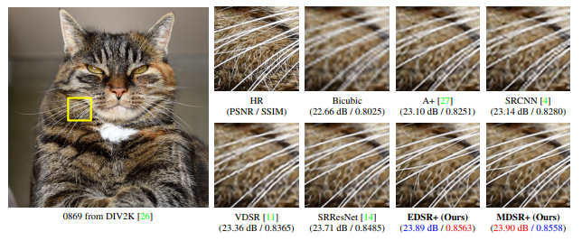
What is Image Super-Resolution?
Lim, Bee, et al. “Enhanced deep residual networks for single image super-resolution”
a1 |  | a2 |  | a3
b1 |  | b2 |  | b3
c1 |  | c2 |  | c3
a1 |  | a2 |  | a3
b1 |  | b2 |  | b3
c1 |  | c2 |  | c3
a1 | a2 | a3
b1 | b2 | b3
c1 | c2 | c3

Slide 5
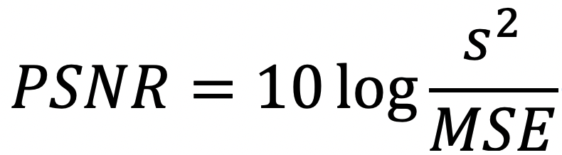
What is Image Super-Resolution?
Lim, Bee, et al. “Enhanced deep residual networks for single image super-resolution”
(dB)
PSNR of image A is 1dB higher than that of B
= A is 10 times better than B
= A is 10 times more similar to GT than B

Slide 6
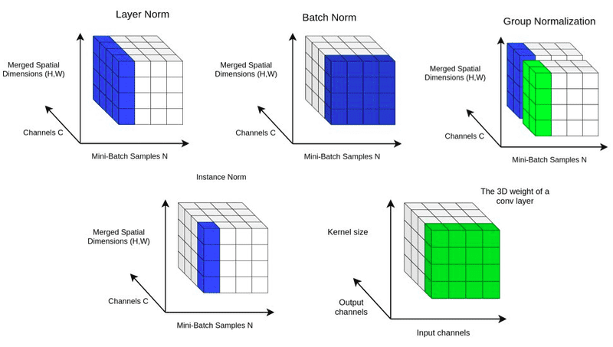
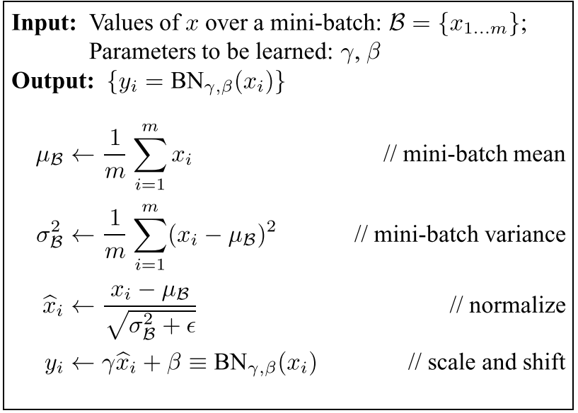
What is Normalization?
Ioffe, Sergey, and Christian Szegedy. "Batch normalization: Accelerating deep network training by reducing internal covariate shift."
https://theaisummer.com/normalization/
Enable applying higher learning rate
Make it easier to find loss surface
Improve model performance
1) Reduce Internal Covariate Shift (S. Ioffe, 2015)
2) Make Loss function more Lipschitz-continuous (S. Santurkar, 2018)

Slide 7
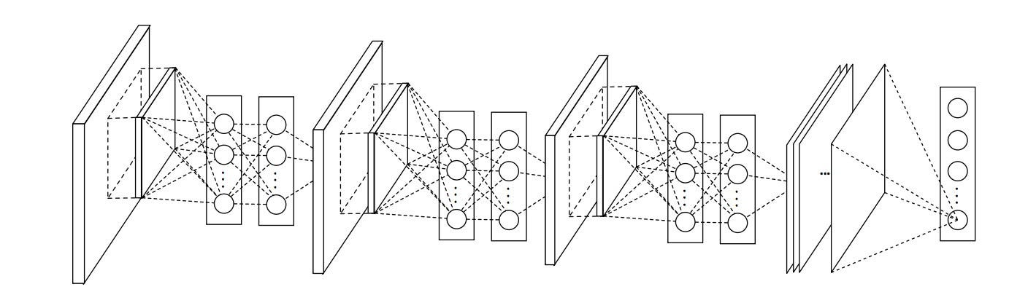
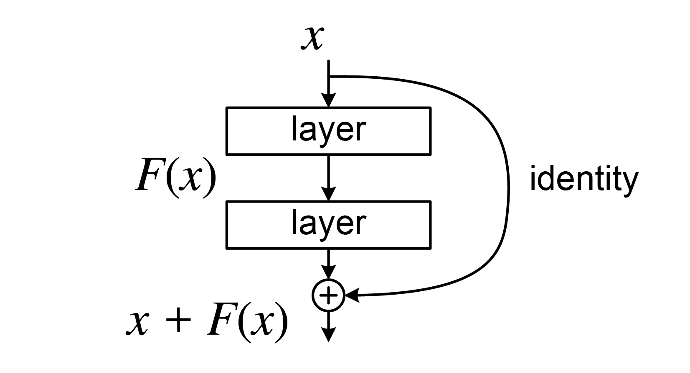
What is a Residual Network?
https://github.com/getmykhan/DCNN
Making network deeper and deeper led to a quick reduction in training accuracy
“Degradation problem”
Skip connection allows stacking more layers
https://en.wikipedia.org/wiki/Residual_neural_network

Slide 8
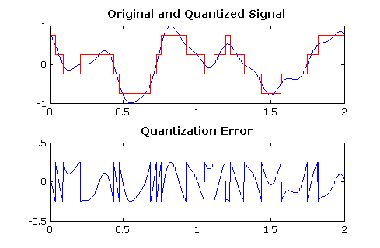
What is Quantization?
D. Ventzas, “PEAK SEARCHING ALGORITHMS and APPLICATIONS”
Continuous Signal
Discrete Signal
Analog Signal
Digital Signal

Slide 9
What is Quantization?
Quantize weights and activation values
Requires many many BitOPs
FP32
FP32
Requires lesser BitOPs
Int (n-bits)
Int (n-bits)
Quantization lets us get similar results
with extremely less BitOPs

Slide 10
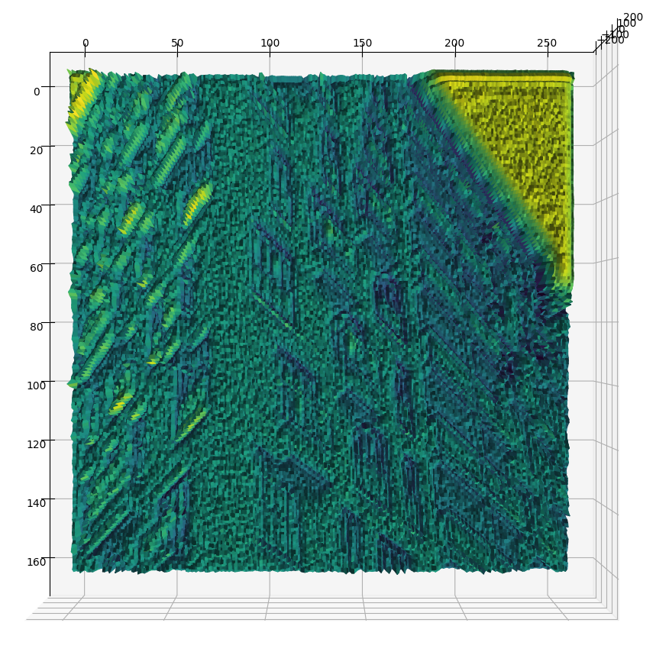
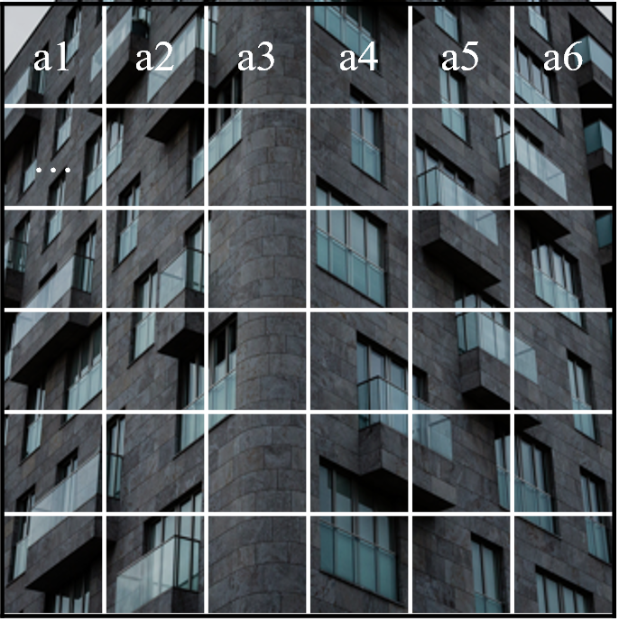
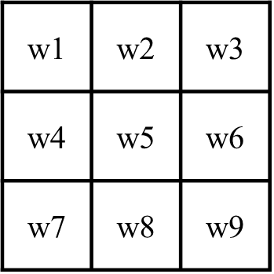
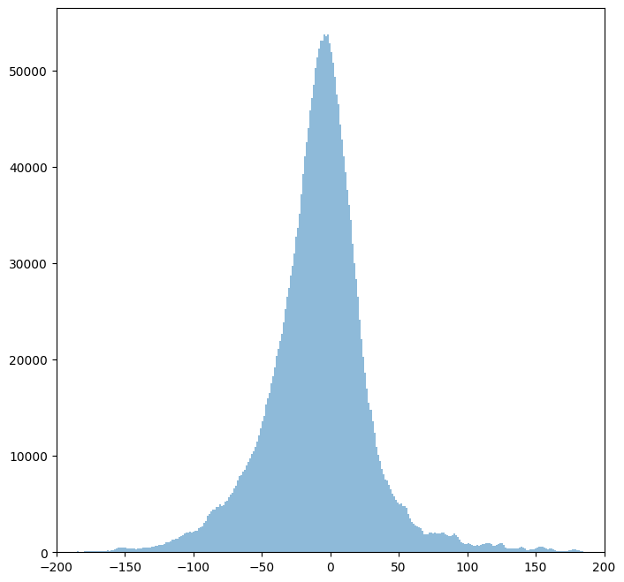
What is Quantization?
*
=
Kernel
Image
Activation
Histogram of activation

Slide 11
What is Quantization?
count
0
1
2
3
4
5
6
7
8
9
10
11
12
13
14
15
16
17
18
19
20
21
22
23
24
25
26
27
28
29
30
31
value
0000
0001
0010
0011
0100
0101
0110
0111
1000
1001
1010
Histogram of activation

Slide 12
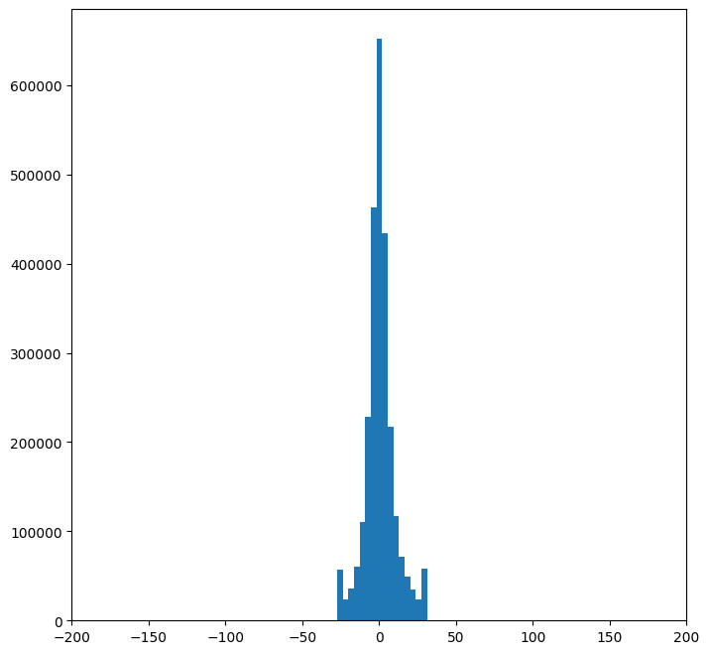
What is Quantization?
count
0
1
2
3
4
5
6
7
8
9
10
11
12
13
14
15
16
17
18
19
20
21
22
23
24
25
26
27
28
29
30
31
value
0000
0001
0010
0011
0100
0101
0110
0111
1000
1001
1010
Quantization is a kind of mapping
FP32 to Int

Slide 13
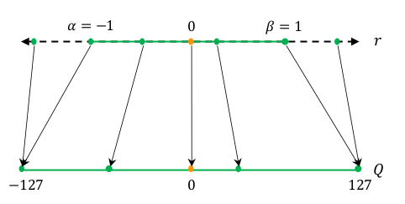
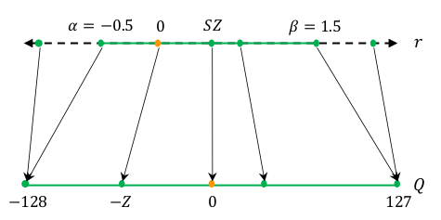
What is Quantization?
Gholami, Amir, et al. "A survey of quantization methods for efficient neural network inference."
Symmetric Quantization
Asymmetric Quantization
PAMS
Quantized Super-Resolution via Parameterized Max Scale
(2020)
DDTB
Dynamic Dual Trainable Bounds for Ultra-low Precision Super-Resolution Networks
(2022)

Slide 14
What is Quantization?
Given a quantization bit precision (2, 4, 8, …),
Finding appropriate quantization range is important
to minimize quantization error.

Slide 15
Introduction
Emergence of EDSR
Should BN be eliminated?

Slide 16
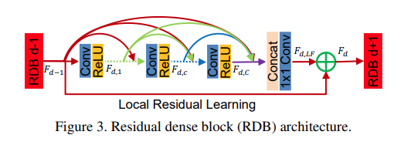
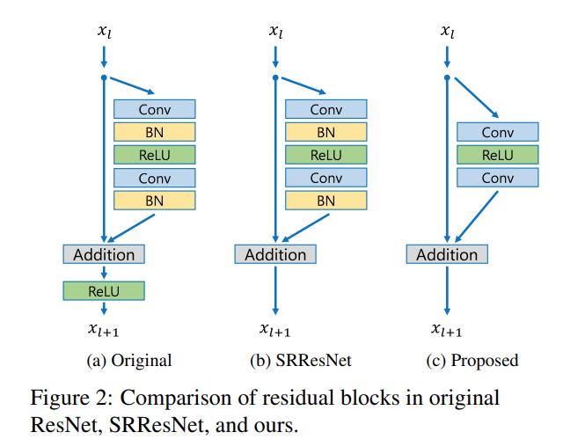
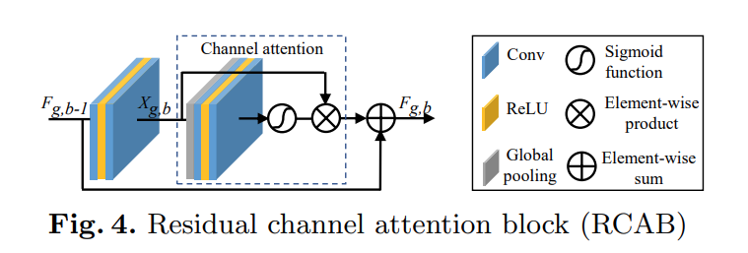
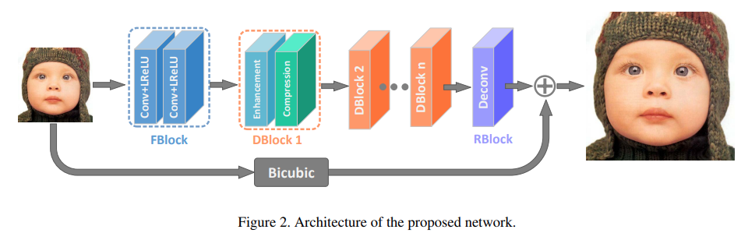
Emergence of EDSR
RDN
Zhang, Yulun, et al. "Residual dense network for image super-resolution."
RCAN
Zhang, Yulun, et al. "Image super-resolution using very deep residual channel attention networks.”
Lim, Bee, et al. “Enhanced deep residual networks for single image super-resolution,”
EDSR
IDN
Hui, Zheng, Xiumei Wang, and Xinbo Gao. "Fast and accurate single image super-resolution via information distillation network."

Slide 17

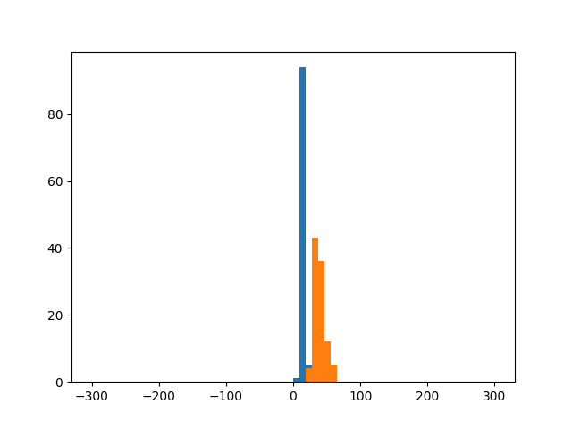
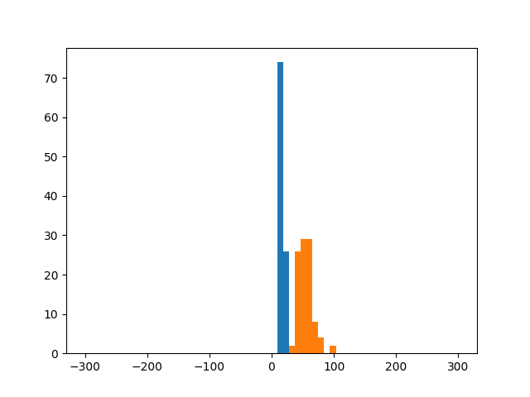
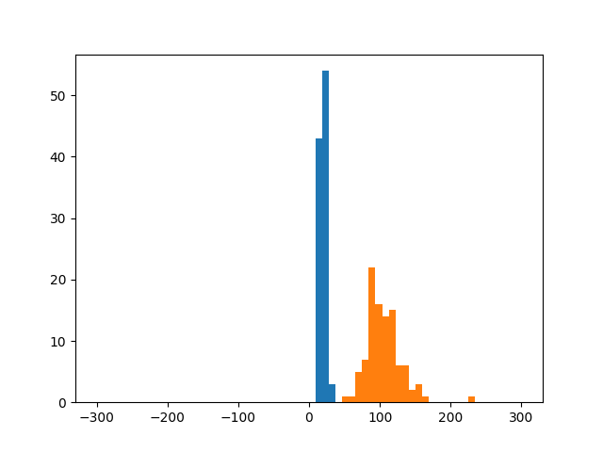
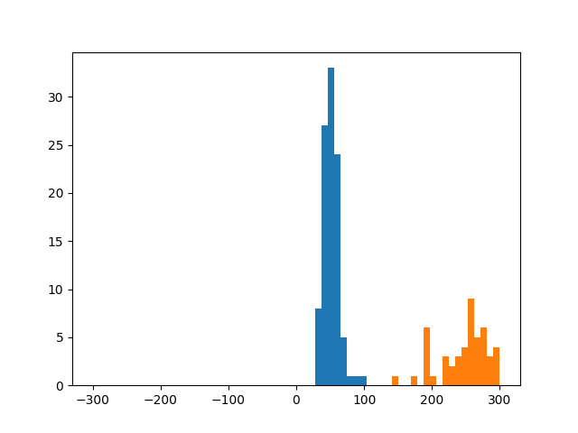


Should BN be eliminated?
EDSR
Conv
ReLU
Conv
$$⋯$$
Conv
ReLU
Conv
$$⋯$$
Conv
ReLU
Conv
Low Resolution
High Resolution
Conv11
Conv17
Conv23
Conv31
The distribution of activation is very dynamic
Not quantization friendly!

Slide 18
Impact of Normalization on Quantization
Limit of Quantization Unfitness
Downscaling of Quantization interval

Slide 19
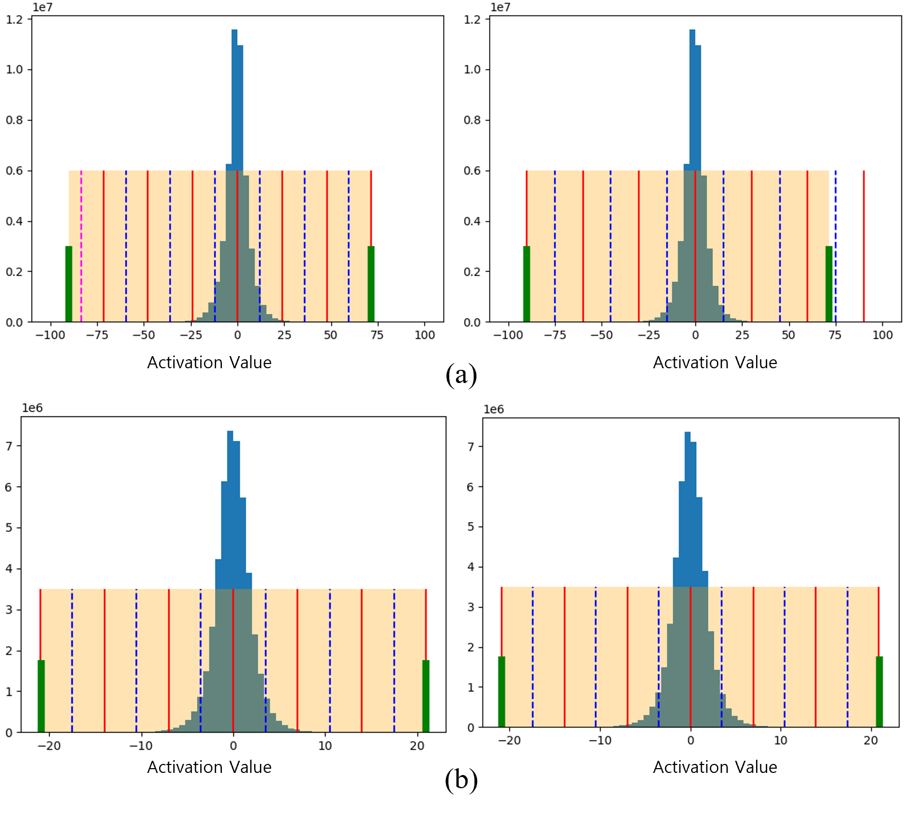
Limit of Quantization Unfitness
Conv
ReLU
Conv
Conv
BN
ReLU
Conv
BN
EDSR
EDSR + BN
Activation of EDSR
Activation of EDSR+BN
Wider quantization gap
Waste of quantization level
Less quantization error!

Slide 20
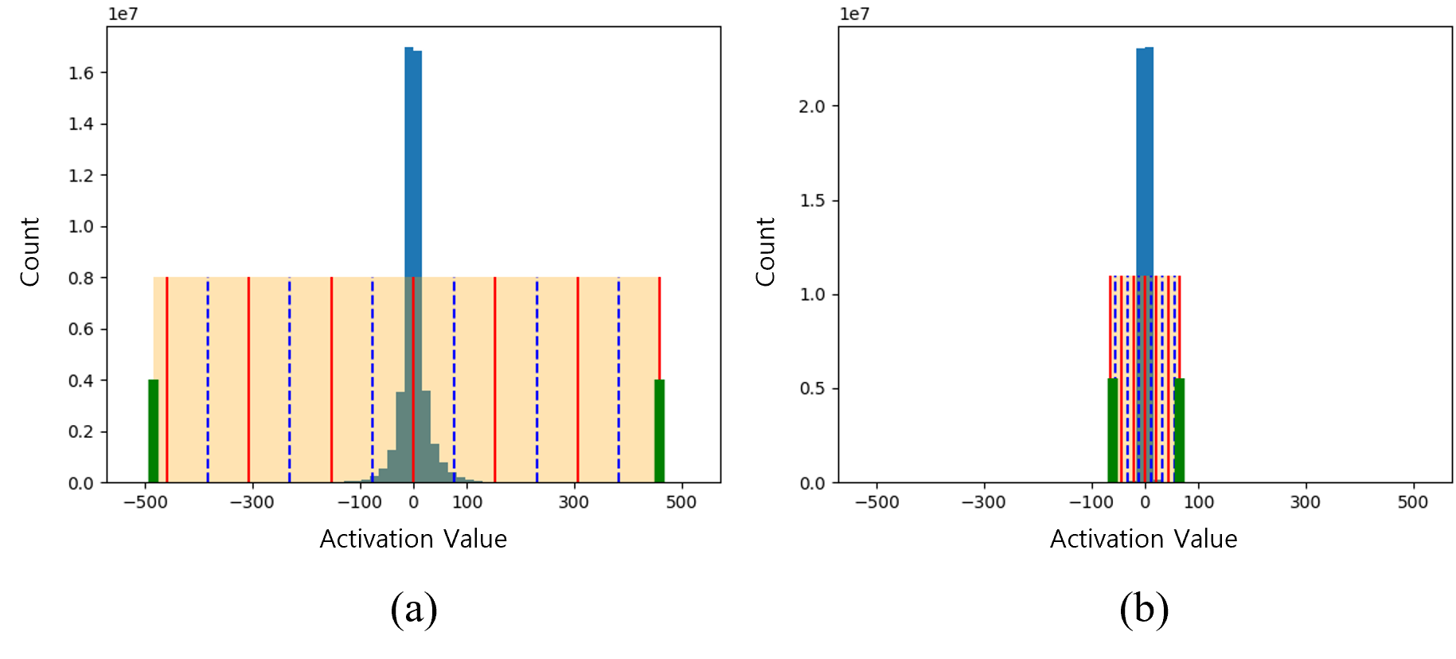
Downscaling of Quantization interval
Conv
ReLU
Conv
Conv
BN
ReLU
Conv
BN
EDSR
EDSR + BN
123.25 / Quantization level
19.5 / Quantization level
Less quantization error!

Slide 21
Experiments
Experiment Settings
Comparison with PAMS
Comparison with DDTB

Slide 22

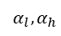
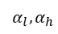

Experiment Settings
Conv
BN
ReLU
Conv
BN
Similar approach applied on IDN
EDSR + BN (EDSR†)
Conv
BN
ReLU
Conv
BN
Conv
BN
ReLU
Conv
BN
Q
Q
Q
Q
Q
Q
Q
Q
$$α$$
$$α$$
$$α_{l},α_{h}$$
$$α_{l},α_{h}$$
EDSR + BN + PAMS
EDSR + BN + DDTB

Slide 23
Comparison with PAMS
PAMS shows better performance when BN is included
 | Precision | Urban100 | Test2k | Test4k
EDSR | - | 26.02 | 27.59 | 28.99
EDSR† | - | 25.84 | 27.54 | 28.92
EDSR+PAMS | 8bits | 26.03 | 27.59 | 28.98
+ w/ BN (ours) | 8bits | 25.85 | 27.54 | 28.92
EDSR+PAMS | 4bits | 25.30 | 27.40 | 28.73
+ w/ BN (ours) | 4bits | 25.40 | 27.39 | 28.73
EDSR+PAMS | 3bits | 23.50 | 26.59 | 27.69
+ w/ BN (ours) | 3bits | 25.00 | 27.31 | 28.60
IDN | - | 25.50 | 27.40 | 28.74
IDN† | - | 25.53 | 27.42 | 28.76
IDN+PAMS | 8bits | 25.46 | 27.39 | 28.73
+ w/ BN (ours) | 8bits | 25.50 | 27.41 | 28.75
IDN+PAMS | 4bits | 24.35 | 26.91 | 28.11
+ w/ BN (ours) | 4bits | 24.64 | 27.03 | 28.27
IDN+PAMS | 3bits | 23.24 | 26.36 | 27.44
+ w/ BN (ours) | 3bits | 23.99 | 26.71 | 27.89

Slide 24
Comparison with DDTB
DDTB shows better performance when BN is included
 | Precision | Urban100 | Test2k | Test4k
EDSR | - | 26.02 | 27.59 | 28.99
EDSR† | - | 25.84 | 27.54 | 28.92
EDSR+DDTB | 8bits | 26.03 | 27.60 | 28.99
+ w/ BN (ours) | 8bits | 25.81 | 27.54 | 28.92
EDSR+DDTB | 4bits | 25.66 | 27.51 | 28.86
+ w/ BN (ours) | 4bits | 25.55 | 28.49 | 28.85
EDSR+DDTB | 3bits | 25.34 | 27.41 | 28.72
+ w/ BN (ours) | 3bits | 25.31 | 27.42 | 28.75
IDN | - | 25.50 | 27.40 | 28.74
IDN† | - | 25.53 | 27.42 | 28.76
IDN+DDTB | 8bits | 25.02 | 27.26 | 28.53
+ w/ BN (ours) | 8bits | 25.03 | 27.27 | 28.54
IDN+DDTB | 4bits | 24.73 | 27.12 | 28.34
+ w/ BN (ours) | 4bits | 24.74 | 27.13 | 28.37
IDN+DDTB | 3bits | 23.73 | 26.66 | 27.81
+ w/ BN (ours) | 3bits | 24.24 | 26.90 | 28.09

Slide 25
Conclusion

Slide 26
Conclusion
1. Researchs on DCNN-based SR model tend to remove BN from the network
2. Our experiment shows that adding BN can reduce quantization error for low bit precision
3. Problems including high memory requirements and high-frequency component losses still exists
4. Research on new normalization algorithms specialized for quantization needs to be followed up

Slide 27
[1] Dong, Chao, et al. “Image super-resolution using deep convolutional networks,” IEEE Transactions on Pattern Analysis and Machine Intelligence, vol. 38, no. 2, pp. 295-307, 2015.
[2] Ledig, Christian, et al. “Photo-realistic single image super-resolution using a generative adversarial network,” Proceedings of the IEEE/CVF Conference on Computer Vision and Pattern Recognition, 2017, pp. 4681-4690.
[3] Lim, Bee, et al. “Enhanced deep residual networks for single image super-resolution,” Proceedings of the IEEE/CVF Conference on Com- puter Vision and Pattern Recognition Workshops, 2017, pp. 136-144.
[4] Hui, Zheng, Xiumei Wang, and Xinbo Gao, “Fast and accurate single image super-resolution via information distillation network,” Proceed- ings of the IEEE/CVF Conference on Computer Vision and Pattern Recognition, 2018, pp. 723-731.
[5] Choi, Jungwook, et al. “PACT: Parameterized clipping activation for quantized neural networks,” arXiv preprint arXiv:1805.06085, 2018.
[6] Li, Huixia, et al. “PAMS: Quantized super-resolution via parameterized max scale,” Proceedings of the European Conference on Computer Vision, 2020, pp. 564-580.
[7] Kong, Xiangtao, et al. “ClassSR: A general framework to accelerate super-resolution networks by data characteristic,” Proceedings of the IEEE/CVF Conference on Computer Vision and Pattern Recognition, 2021, pp. 12016-12025.
[8] Zhong, Yunshan, et al. “Dynamic dual trainable bounds for ultra- low precision super-resolution networks,” Proceedings of the European Conference on Computer Vision, 2022, pp. 1-18.

Slide 28
Thank You
Q&A

